Slide 1



Slide 2

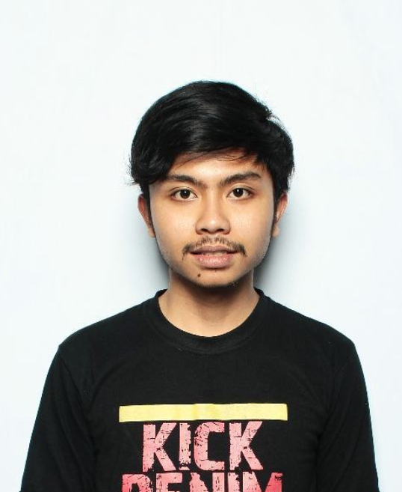
About Me :
YUDHO JANUAR PRAKOSO
Founder Laseblak
Entrepreneur of Khalifah

Slide 3

Cooperation
MARKETING
7
BRAND
MANAGEMEN
PRODUK
FOKUS
AREA

Slide 4

“ KENALI “
MEDAN AREA
A
MATI
T
IRU
M
ODIFIKASI
Notes:
FORMULA 1

Slide 5

“ KUASAI “
PRODUCT KNOWLEDGE
Create market
Make the competition irrelevant
Focus on big picture
Bleeding market
Exploitasi market
Beat the competition
RED OCEAN
BLUE OCEAN
Notes:
FORMULA 2

Slide 6

“ KENCENGIN “
MARKETINGNYA
PRODUCT
PRICE
PLACE
PROMOTION
Ngangenin, Unik, DNA product
IRU
Sesuai Segmen, Selembar, Tidak Krusial
Pusat keramaian, Akses Mudah, Nyaman
Soft Selling, Flashmob, Viral, Kekinian
Notes:
FORMULA 3

Slide 7

“ KONTROL “
MANAGEMENNYA
- KEUANGAN
Cashflow Harian, Mingguan, Bulanan, Semesteran, Tahunan
- PEOPLE
Leadership
Communication
Personality Plus
Notes:
FORMULA 4

Slide 8

“ KONTROL “
MANAGEMENT KEUANGAN
Marketing Plan yang “terlihat” Menguntungkan
Anggaran Pengeluaran yang minim
Penambahan Ruang Pemasukan
Investasi dulu, Baru Gengsi
Notes:
MASIH FORMULA 4

Slide 9

CARA MEMBUAT DAFTAR NAMA
No | Nama | F | A | S | T | SP | No. Telp
1. | Alex | 1 | 1 | 1 | 1 | 4 | 082xxxxxxxxxxx
2. | Bobi | 2 | 2 | 2 | 2 | 8 | 082xxxxxxxxxxx
3. | Caca | 3 | 3 | 3 | 3 | 12 | 082xxxxxxxxxxx
NILAI SP
TOLAK UKUR
4-6 | KURANG POTENSI
7-9 | POTENSI SEDANG
10-12 | SANGAT POTENSI
1 | KURANG DARI SAYA
2 | SAMA DENGAN SAYA
3 | LEBIH DARI SAYA
Notes:
MASIH FORMULA 4

Slide 10

“ KONTROL “
MANAGEMENT PEOPLE
‘ Powerful ‘
CHOLERIC
‘ Perfect ‘
Melancholic
EXTROVERT
INTROVERT
IRU
‘ Popular ‘
Sanguin
‘ Peaceful ‘
Phlegmatic
Cara Cepat Menentukan :
Penampilan
Sorot Mata
Cara Makan
Cara Berjalan
Cara Berbicara
MANUSIANYA
Notes:
MASIH FORMULA 4

Slide 11
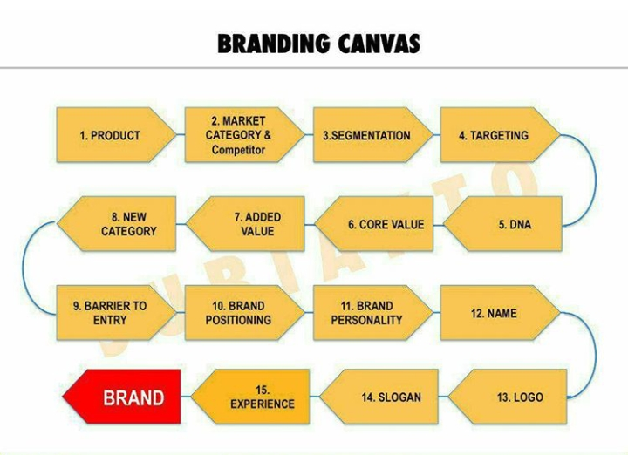
“KIBARKAN” BRANDINGNYA
IRU
Notes:
FORMULA 5

Slide 12


“ KOLAB IN“ BISNISNYA
COMPENSATION / KOMPENSASI
RESISTANCE / RESISTENSI
DIVERSITY / BERAGAM
CLARITY / JELAS
FLEXIBILITY / FLEKSIBEL
FAMILY / KELUARGA
Notes:
FORMULA 6

Slide 13

“ KONSISTENIN “ BISNISNYA
Bearing
Freedom
Multipliying
Systemizing
Profiting
Starting
Notes:
FORMULA 7

Slide 14

